Slide 1

CardioAI – Intelligent Heart Disease Risk Prediction System
Under the Esteemed Guidance of
Dr. V. Shanmukha Rao
Batch no : 17
Submitted by
P.Sravan Kumar 22KT1A4353
SK. Rehan 22KT1A4355
B.Tharun Raj 23KT5A4303
T.Teja 23KT5A4307

Slide 2
CONTENTS
Introduction
Abstract
Literature Survey
Existing System
Proposed System
Requirement Analysis
System Architecture
UML Diagrams

Slide 3
INTRODUCTION
Cardiovascular diseases are among the leading causes of mortality worldwide, necessitating early detection and preventive care.
CardioAI is an intelligent healthcare platform designed to predict heart disease risk using machine learning techniques. The system employs a Random Forest classification model trained on real-world clinical datasets to accurately assess patient risk levels
A secure, web-based dashboard allows users to input physiological parameters, upload medical reports, and receive real-time diagnostic insights along with personalized clinical, dietary, and lifestyle recommendations. By combining predictive analytics, data security mechanisms, and population health monitoring, CardioAI aims to support both healthcare professionals and individuals in proactive heart health management.

Slide 4
ABSTRACT
Heart disease is one of the leading causes of mortality worldwide, making early and accurate diagnosis essential.This project presents an AI-based heart disease assessment system that predicts the risk using machine learning techniques with clinical parameters .A Random Forest classifier is trained on heart disease datasets to identify patterns associated with healthy and diseased conditions.The system provides real-time predictions through a user-friendly interface, assisting healthcare professionals in informed decision-making.
Keywords: Heart Disease, Machine Learning, Random Forest, Risk Prediction, Clinical Parameters, Decision Support System, Logistic Regression, Support Vector Machine, Early Diagnosis, Healthcare AI

Slide 5
ABSTRACT
In our experiments, we trained and tested these algorithms on the heart disease dataset. Among them, the Random Forest classifier achieved the highest accuracy, demonstrating better performance in handling feature interactions and reducing overfitting through ensemble learning. This comparison clearly shows that Random Forest is more robust, reliable, and suitable for real-time heart disease prediction compared to other models.
ALGORITHAM | ACCURACY
SVM | 60
DECISION TREE | 83
RANDOM FOREST | 92

Slide 6
LITERATURE SURVEY
S.NO. | AUTHOR | TITLE | PUBLISHED YEAR | ALGORITHM | METHODOLOGY | DATASET | ACCURACY
1 | Cleveland et al. | Heart Disease Prediction Using Logistic Regression | 2024 | Logistic Regression | Used UCI dataset with basic clinical attributes | UCI Heart Dataset | ~77%
2 | Patel et al. | SVM-Based Heart Disease Risk Assessment | 2023 | SVM | Normalized clinical records analyzed using SVM | Clinical Records | 81%
3 | Kumar et al. | Decision Tree Model for Heart Disease Diagnosis | 2023 | Decision Trees | Hospital data classified using Decision Trees | Hospital Data | 83%
4 | Ch. Anwar et al. | Effectively Predicting the Presence of Coronary Heart Disease Using Machine Learning Classiﬁers | 2022 | GBA, MLP | Applied multiple machine learning classifiers on the UCI Heart Disease dataset to predict coronary heart disease. | UCI Heart Disease | 90%

Slide 7
S.NO. | AUTHOR | TITLE | PUBLISHED YEAR | ALGORITHM | METHODOLOGY | DATASET | ACCURACY
5 | Jaswanth Narayana et al. | Heart Disease Prediction Using Machine Learning | 2022 | KNN | Used a public health dataset and applied KNN after basic data analysis and feature distribution checking. | Public Health Dataset | 84.86%
6 | Ahmad Shaket al. | Machine learning models for prediction of co-occurrence of diabetes and cardiovascular diseases: a retrospective cohort study | 2022 | Random Forest | Used UCI heart disease data and applied random forest on retrospectively collected clinical records. | UCI Heart Disease | 91%
7 | Sharma et al. | Heart Disease Prediction | 2022 | Random Forest | ECG signals combined with clinical features | ECG + Clinical | 85%
8 | Adarsh Sharma et al. | Heart Disease Prediction: A Comparative Analysis of Machine Learning Algorithms | 2021 | Random Forest | Collected and cleaned heart disease data, handled missing values, normalized features, and applied Random Forest. | Heart Dataset | 84.96%

Slide 8
EXISTING SYSTEM
In the existing heart disease diagnostic systems, traditional methods largely rely on manual evaluation by healthcare professionals based on clinical symptoms, medical history, and standard diagnostic tests such as ECG, blood tests, and imaging. While these methods are effective, they are often:
Time-Consuming: Doctors need to analyze multiple parameters manually, which can delay diagnosis.
Subjective: Diagnosis may vary depending on the experience and expertise of the physician.
Limited in Pattern Recognition: Traditional methods may fail to detect complex patterns and interactions among multiple risk factors
DISADVANTAGES
Time-consuming diagnosis - Manual analysis of medical reports takes significant time.
Human error and subjectivity - Diagnosis depends on doctor's experience, leading to inconsistent results.
Limited accuracy - Rule-based systems cannot adapt to new patterns in data.
Single machine learning models often suffer from overfitting or underfitting.

Slide 9
PROPOSED SYSTEM
The proposed system is an AI-based heart disease assessment platform that uses Random Forest classifier to predict risk. The system takes patient medical parameters such as age, gender, blood pressure, cholesterol levels, and heart rate as input. Data is preprocessed to handle missing values and normalize features before model training.
ADVANTAGES
High prediction accuracy through Random Forest ensemble approach.
Early detection of heart disease before severe symptoms appear.
Automated and fast assessment - Results within seconds.
Reduced human error with consistent and reliable predictions.
Handles complex medical data and captures hidden relationships.

Slide 10
WHY RANDOM FOREST IS CHOSEN
High Accuracy - Combines multiple decision trees, improving prediction accuracy.
Handles Non-Linear Data - Medical data is complex; Random Forest captures these patterns effectively.
Reduces Overfitting - Averaging results from many trees avoids overfitting.
Works Well with Medical Datasets - Efficient even with missing values and mixed data types.
Feature Importance - Identifies important health parameters like cholesterol, blood pressure, and age.
Robust and Reliable - Suitable for real-world healthcare applications.

Slide 11
FUNCTIONAL AND NON-FUNCTIONAL REQUIREMENTS
FUNCTIONAL REQUIREMENTS
NON-FUNCTIONAL REQUIREMENTS
Input patient medical details
Validate input data
Preprocess medical data
Apply Random Forest algorithm
Predict heart disease risk
Display prediction results
High prediction accuracy
Fast response time
Scalability
Data security and privacy
Reliability and robustness
User-friendly interface

Slide 12
SOFTWARE AND HARDWARE REQUIREMENTS
SOFTWARE REQUIREMENTS
Operating System: Windows
Programming Language: Python 3.9, Kotlin
Backend Framework: Flask / FastAPI
Frontend: HTML, CSS, JavaScript
Android Studio (Latest stable version)
Android SDK
Libraries: NumPy, Pandas, Scikit-learn, Matplotlib, Seaborn, Flask/Streamlit
HARDWARE REQUIREMENTS
Processor: Intel i5 or higher
RAM: Minimum 8 GB
Storage: Minimum 50 GB

Slide 13
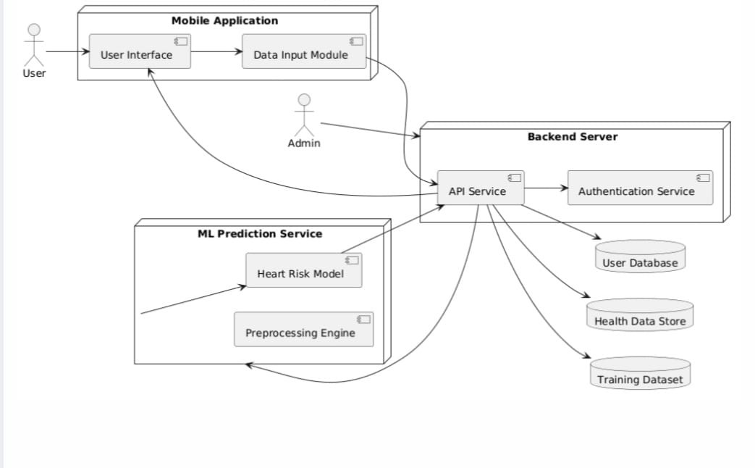
SYSTEM ARCHITECTURE

Slide 14
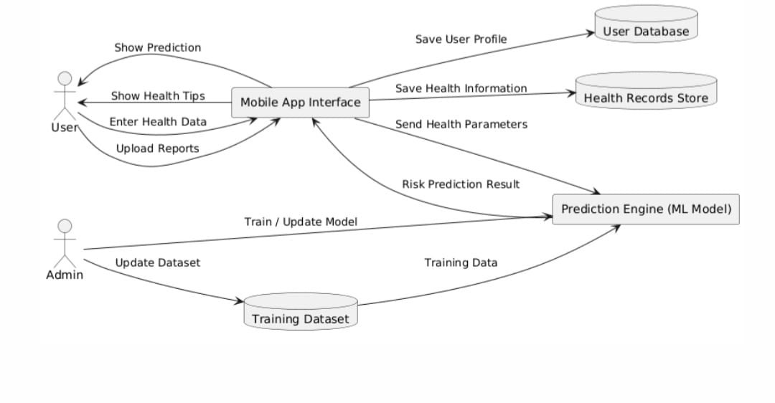
DATA FLOW DIAGRAM

Slide 15
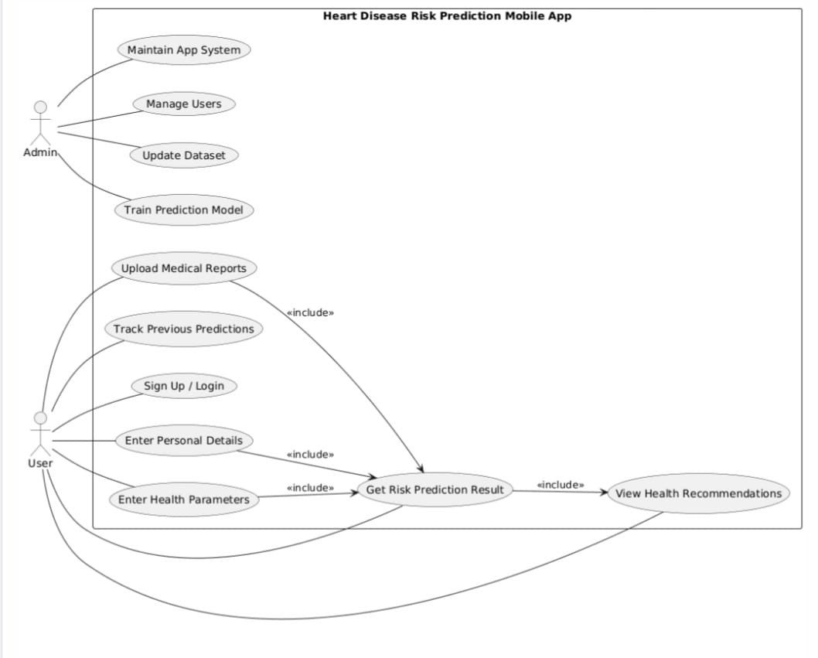
USE CASE DIAGRAM

Slide 16
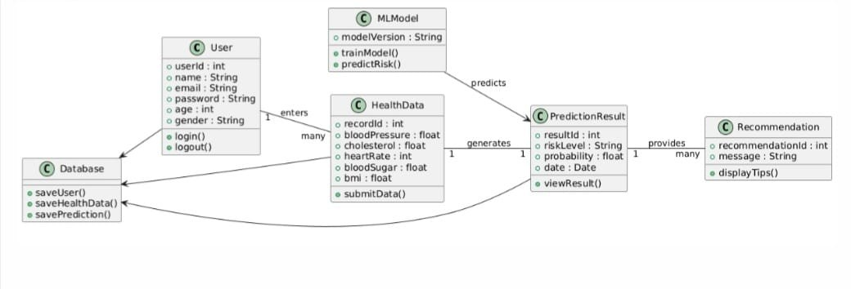
CLASS DIAGRAM

Slide 17
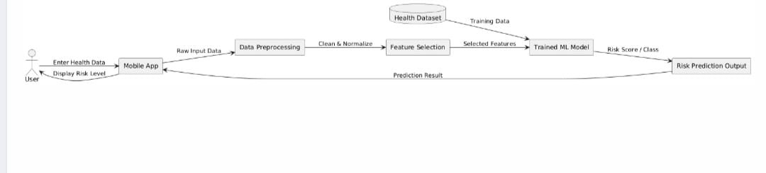
MODEL DIAGRAM

Slide 18
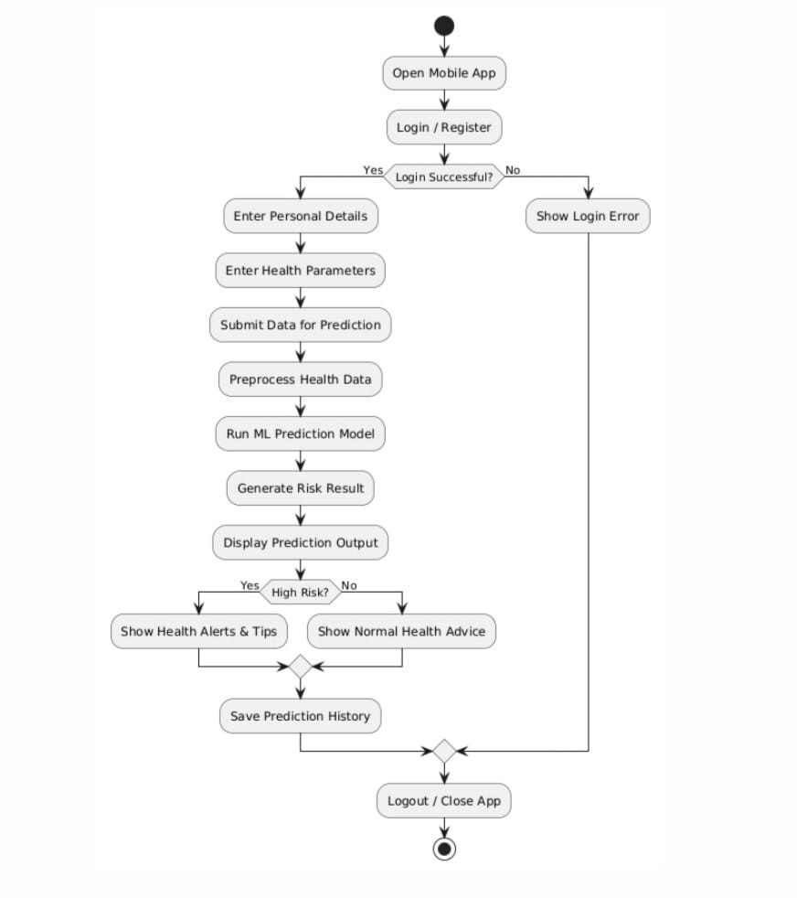
ACTIVITY DIAGRAM

Slide 19
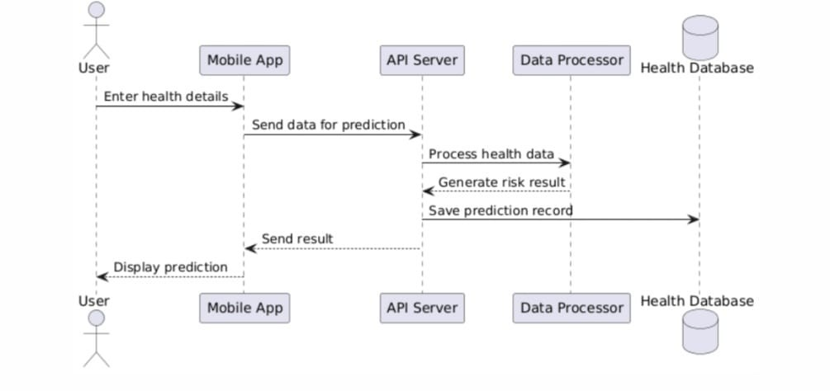
SEQUENCE DIAGRAM

Slide 20
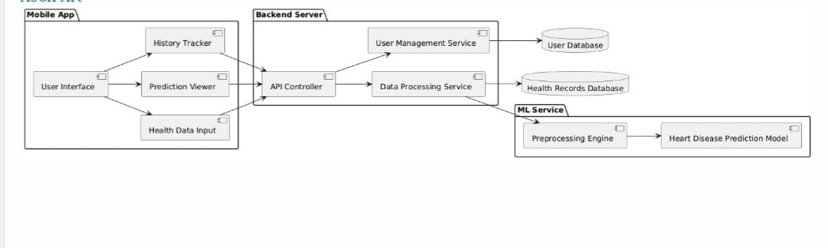
COMPONENT DIAGRAM

Slide 21
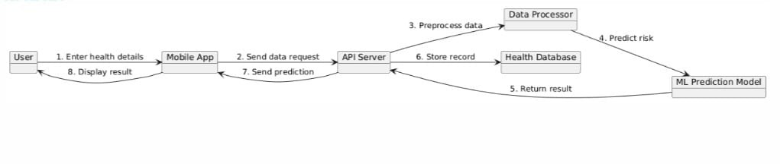
COLLABORATION DIAGRAM

Slide 22
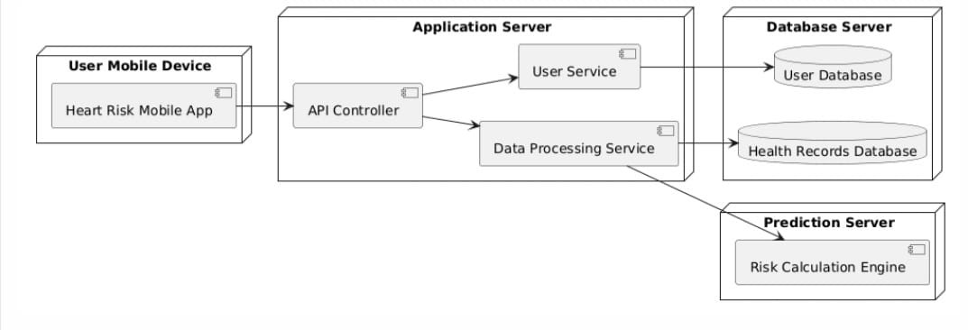
DEPLOYMENT DIAGRAM

Slide 23
REFERENCES
L. Breiman, Random Forests, Machine Learning, 45(1):5–32, 2001.
UCI Machine Learning Repository, Heart Disease Dataset, https://archive.ics.uci.edu/ml/datasets/heart+disease
Pedregosa et al., Scikit-learn: Machine Learning in Python, Journal of Machine Learning Research, 2011.
Heart Disease Prediction: A Comparative Analysis – This paper compares machine learning models for predicting heart disease using clinical data.

Slide 24
Thank you !

